Slide 1

CA326 - YEAR 3 PROJECT
Student Attendance Application
Nigel Guven
Robert Doran

Slide 2

Project Description
How to effectively track attendance to lectures/labs/tutorials.
Develop Android application to do so. Utilise NFC technology.
Student Cards & Smart Phones are NFC compatible.
Reader picks up unique Hex number e.g 8C 64 4B F6
Hex number relates to student details. Where?
Students register details on the app.
Registry team link Hex number to details on database.
Lecturer downloads app and has special privileges.
Students attend class and bring ID card.
Tap card on lecturers phone. Phone reads card via NFC.
Application acknowledges card and logs student attendance.
Attendance data transmitted to database

Slide 3
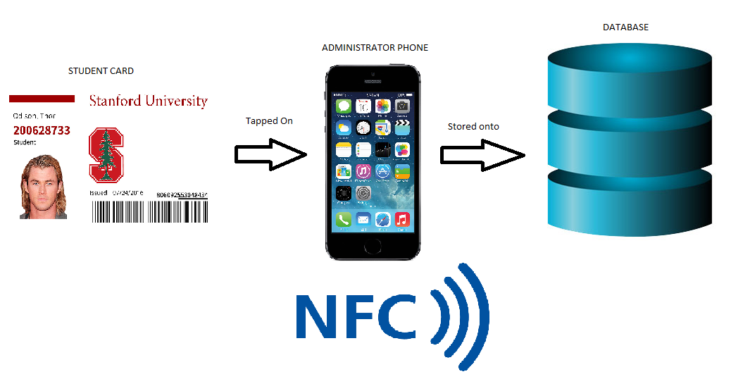

Slide 4
Requirements
Android Studio - To make the android app
Android Emulator - To run the app on a PC instead of installing it onto a phone every time changes are made.
A PC - DCU computer labs + laptops.
Github
Java Development Kit 5 or later.
MySQL workbench for developing the database.
An Android phone which is NFC compatible.

Slide 5
Planning the Work - Agile development
November 2017
Key Areas of Research
Android App Development
NFC Programming
Database I/O
Manipulate RFID
Functional Specification
System Design
Build Database Template
Android Studio Setup
December - February 2018
Intensive Programming
NFC Permissions
Link with Database
Develop Interface on Android Studio
Software Testing
March 2018
Publish Project on Play Store
Release Deliverables
System
Technical Spec
User Manual
Blog/Github
Video Walkthrough
Supervision Forms
Demonstrate to Staff

Slide 6
Challenges
Obtaining students information (Student number, Student name, Student programme, Student year) to link to their NFC tag as the DCU student card NFC record is encrypted. Creating a database to store this information as well as linking that database to the app.
Learning Android Studio and developing our first Android App.
A challenge we overcame, we originally intended on using a Raspberry pi and NFC scanner to record students attendance. We decided it would be a lot easier to develop an Android app for phones that are NFC ready.

Slide 7
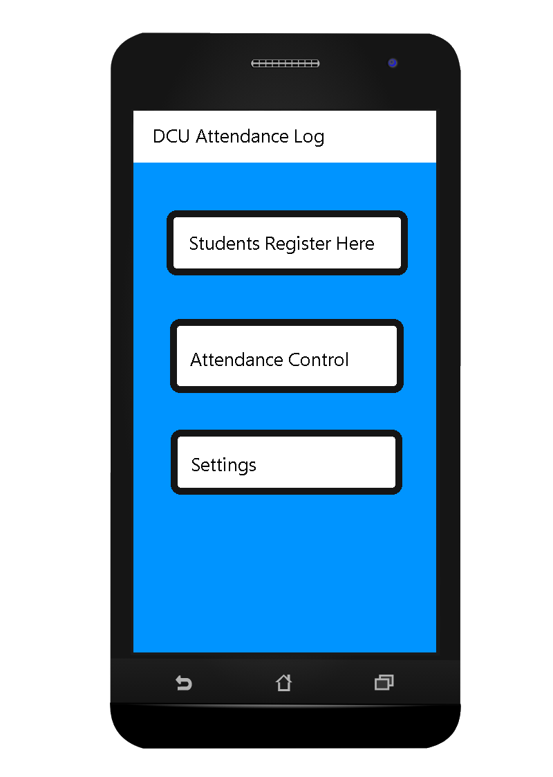
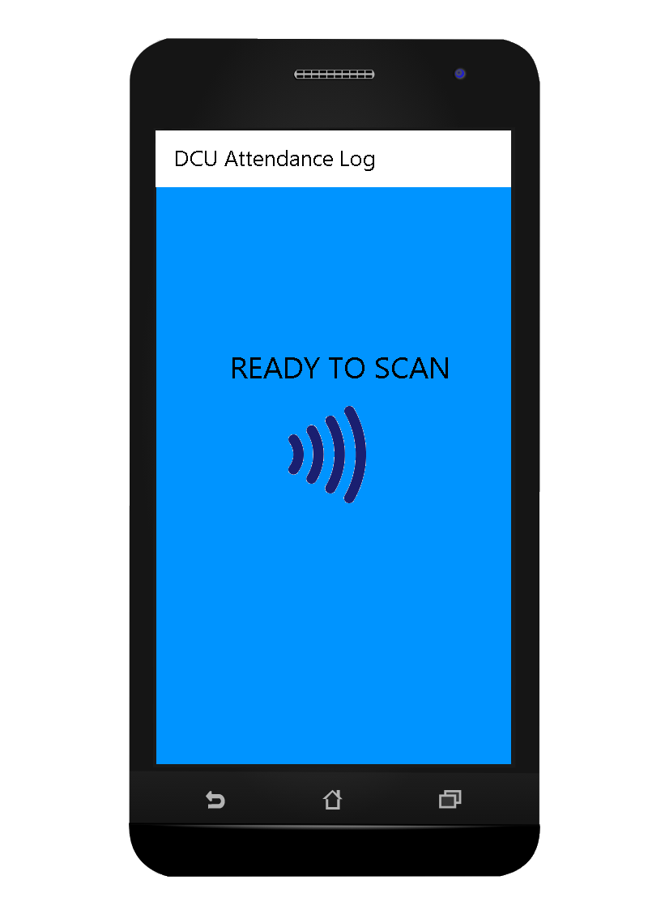
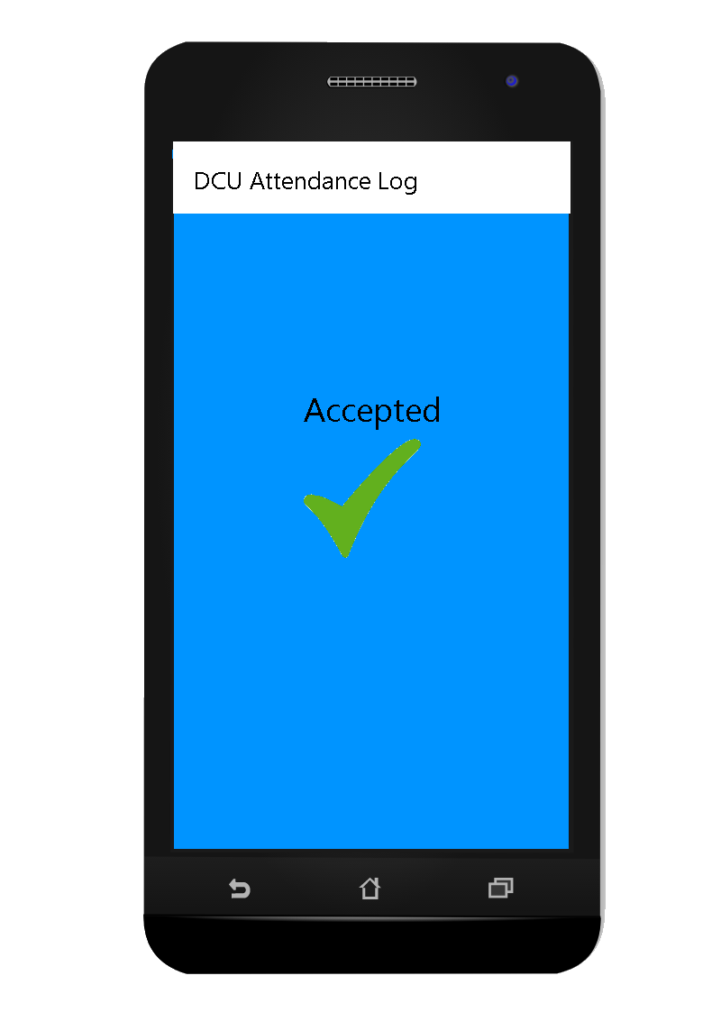
Mock up Interfaces

Slide 8
What we hope to learn.
How to build a database using MySQL and link that database to an Android app.
How to efficiently and effectively divide work for a large scale project.
How to make a well rounded Android App using Android Studio and an Android emulator.

Slide 9
Any Questions?

